Slide 2
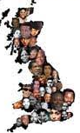
How are we celebrating?
The History department are running a poster competition about great Black Britons; be sure to enter!
In your PE lesson you will be looking at Black female role models in fitness and sports. Who is your all time favourite sporting hero? Dame Kelly Holmes? Natasha Jonas?
On Wednesday 20th Miss Dias is hosting an Alumni event, talking to ex-Ursuline Women of Colour

Slide 3
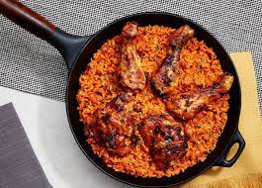
On Wednesday 20th we will be selling food from around the world at break and lunch so bring a full purse and an empty belly!
In DT you will be looking at black designers and inventors
On Thursday 21st we will be celebrating our diversity with a mass led by Fr Richard from Thamesmead & his Choir
Assemblies are happening all month celebrating inspiration people of colour

Slide 4
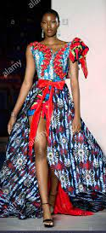
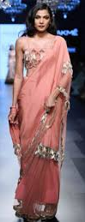
Collective Worship this month is focusing on Black History including people of incredible influence
Be sure to check out Ms Deegan’s Black History reading list. The new additions to the library this year are EXTRA special!
On Wednesday 20th we will be hosting a FASHION SHOW for YR 7-11, after school. Be prepared to be dazzled by the beautiful outfits!

Slide 5
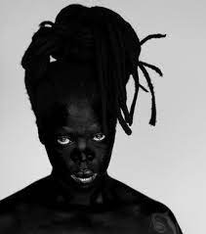
The Art department are showing their classes a range of black female artists linked to their project work. Do you remember this artist and their work?
The English department will be live streaming a Black History Month creative workshop hosted by Eastside Online on Wednesday 20th
Miss Dias will be sending out a form quiz that covers the incredible people we explored last year in our 365Black History presentations. Prizes for winning form! Good Luck!
Notes:
Artist: Zanele Muholi

Slide 6
#Proudtobe - Collective Worship
This month, we want to take the opportunity to celebrate black culture and take this opportunity to learn more about the black people who have changed History.
Each Form has been given a region to research and celebrate. Complete Collective Worship resources for next week focusing on:
History about your region
Famous people to celebrate from the countries in this area.
A cultural event or celebration that occurs each year and why/how are they celebrated?
Are there any Saints that are associated with any countries in your area?
Prayer/video - celebrating the region and it’s people

Slide 7
North Africa | Europe
South Africa | Australasia
West Africa | North America
East Africa | South America
The Caribbean Islands | Asia
British African | African American
Some suggested places of interest for your presentations
All resources will be shared on the main screen in school.
Presentations will be shared to the year groups in you year assemblies throughout the year.
Displays will be made around the school using the resources.

Slide 8
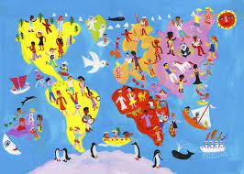
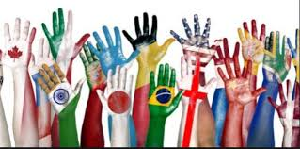
Cultural celebration @ St Ursula’s

Slide 9
WHEN IS THIS TAKING PLACE ?

Slide 10
MONDAY 18TH OCTOBER 2021 & TUESDAY 19TH OCTOBER
WORKSHOPS WILL BE HELD IN EACH DEPARTMENT
Departments will be focusing on celebrating culture,diversity, inclusion within their lessons. Some examples are on the next few slides…

Slide 11
WEDNESDAY 20TH OCTOBER 2021
FOOD FROM AROUND THE WORLD- WILL BE SOLD AT BREAK AND LUNCH
FASHION SHOW FOR YR 7-11 (AFTERSCHOOL)
THURSDAY 21ST OCTOBER 2021
MASS FOR YR 7 AND YR 11 FROM THE CHURCH (THIS WILL BE LIVESTREAMED TO THE OTHER YEAR GROUPS)
FRIDAY 22ND OCTOBER 2021
CHARITIES DAY

Slide 12
FOOD TECH DEPARTMENT
You could be making quick and easy foods from the 4 continents such as :
Africa : Nigeria, puff
Asia :China, spring rolls
Europe: London,battered fish
North America :Mexico,tacos

Slide 13
MUSIC DEPARTMENT
Different songs will taught and learned from different cultures
A quiz could take place
You could look at various genres of musics from different countries around the world.

Slide 14
ENGLISH DEPARTMENT
Could show the different story, poems from different cultures.
Eg. Black, Asian, American, Polish writers (not from the English curriculum)

Slide 15
MATHS AND SCIENCE
Research and showcase famous scientists and mathematicians from a range of diverse cultures who have made influential contributions to their field.

Slide 16
HISTORY DEPARTMENT
Could show the student the amazing work of who and how different cultures built their wealth, village, empire and how the embraced their culture

Slide 17
LANGUAGE DEPARTMENT
Different native speakers could teach a few words from their language and educate the about how they grew in speaking that language

Slide 18
RE DEPARTMENT
This department could show how different cultures embrace their Religion including key beliefs and practices.

Slide 19
GEOGRAPHY DEPARTMENT
Explore different countries that are not really talked about and expand on on their culture, how these people live and explore their culture and traditions.

Slide 20
TEXTILES DEPARTMENT
Could show were the original materials came from
How the culture embrace their clothing
How its being used today and the different meaning between patterns and colours

Slide 21
COMPUTER SCIENCE DEPARTMENT
Showcasing a range of individuals who made successful developments in ICT.
How different cultures might have used these in their time

Slide 22
DRAMA and PE DEPARTMENT
Dances will be held
Acting and performing by the students
Educate them on different culture performing, different artists and actors.

Slide 23
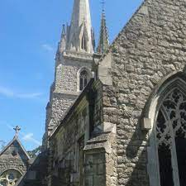
CULTURAL CELEBRATION MASS FOR YR 7&11
We will be celebrating the diversity of our community with a celebration mass on Thursday 21st at 1:25pm
Year 7 and 11 will be in the church
All other year groups will be in school where mass will be live streamed.

